Slide 1
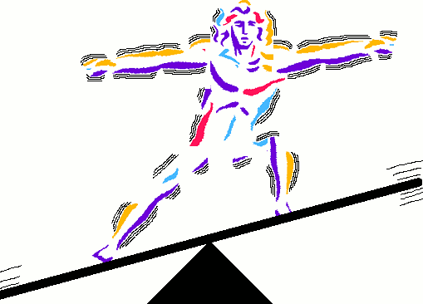
Environmental Factors and Performance
-Relationship between cellular metabolism and production of heat
Thermoregulation basics
Body surface area and thermoregulation
Exercise in heat, risks and precautions
Sweat, humidity and dry environments
Exercise in cold, risks and precautions
Shivering, wind-chill, frostbite

Slide 2
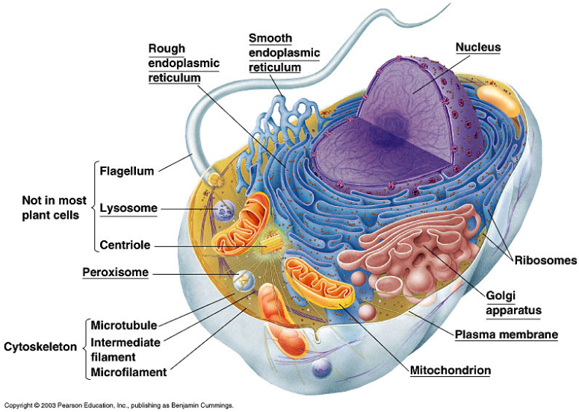
Relationship between cellular metabolism and production of heat
What is involved in cellular metabolism?

Slide 3
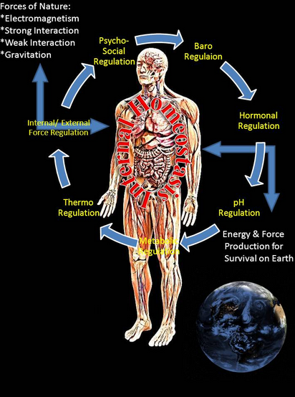
Relationship between cellular metabolism and production of heat

Slide 4
Relationship between cellular metabolism and production of heat
HEAT GAIN → HOMEOSTASIS ← HEAT LOSS
- we need energy that we obtain from food and oxygen to metabolize and maintain homeostasis of core body temperature between 36-38°C
during catabolism, for instance, there is a release of heat energy
not all the energy released can be used to do work and some energy (~80%) is always lost as heat, the rest is stored in ATP
- in a stable thermoneutral environment, at rest, a constant rate of heat will be produced
athletes need more energy because they move more and therefore have higher metabolism and net increase of ATP production
when metabolism increases excess heat is produced and vice versa

Slide 5
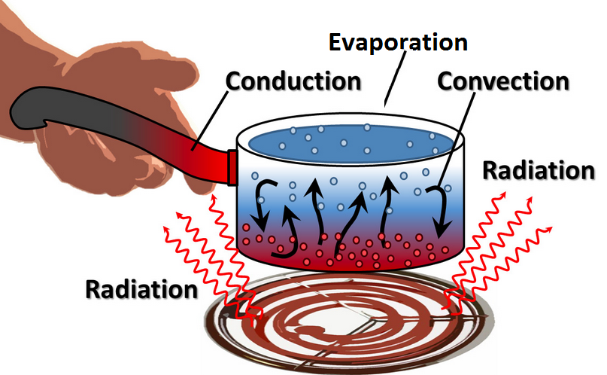
Thermoregulation
Heat from the inner body cools through the blood where the temperature may be up to 6°C lower than the core. Heat is transferred to the environment through 4 mechanisms:

Slide 6
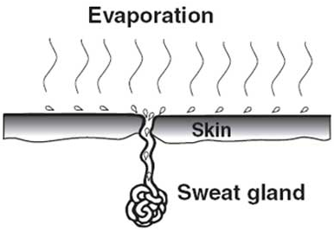
Thermoregulation
Conduction takes place in the body when warm blood from the core shifts to the periphery. Most of the heat loss from the body during exercise takes place due to evaporative cooling (up to 80%) when sweat absorbs the thermic energy from skin and thus converts liquid to a gas. One liter of sweat results in ~2,500 Kj of heat.

Slide 7
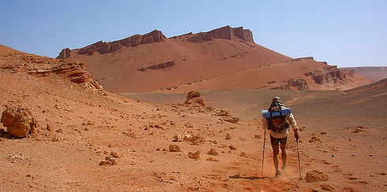
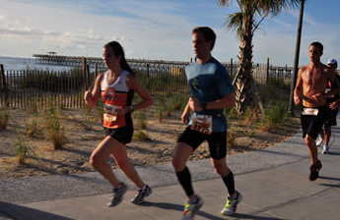
Thermoregulation: Sweat
Dry air receives vaporized sweat readily
Air with high humidity receives less evaporate depending on the amount of water saturation

Slide 8
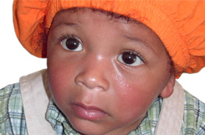
Body surface area and thermoregulation
In general smaller bodies heat and cool faster.
Why?
Smaller bodies have a larger surface area to body volume/mass ratio.
While the surface:mass ratio of smaller people makes them more susceptible to heat and cold weather complications, there are also some studies that show that children do not display this relationship.

Slide 9
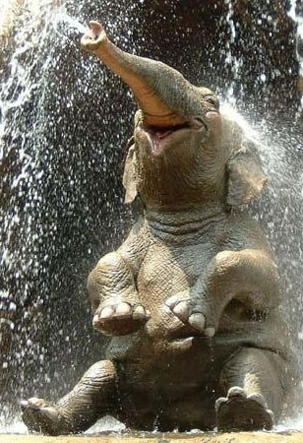
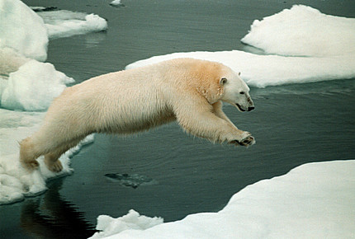
Mammals are adapted to the temperature of their environment
Hot climate mammals have a large surface area: volume ratio. They also have little fur and little body fat for insulation.
Cold climate mammals a small surface area: volume ratio.
They also have thick fur and a lot of body fat under the skin.
Source: vbio.weebly.com, Thermoregulation

Slide 10
Body surface area and thermoregulation
In similar size individuals body composition affects the thermoregulation. Even though the gender differences are small there is a few slight differences in thermoregulation.
What are they?
In general, females have better insulation because of greater subcutaneous fat.
They also have slightly lower relative muscle mass and metabolism, which yields slightly lower heat production.

Slide 11
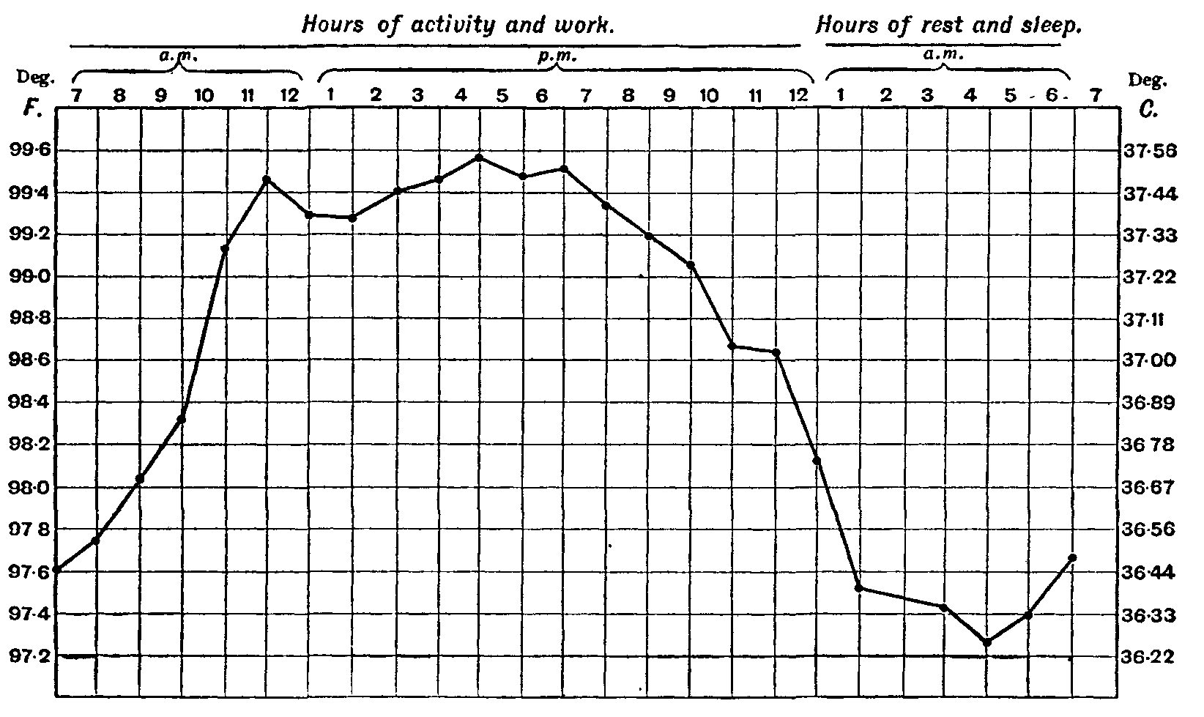
Average temperatures during the day
Source: vbio.weebly.com, Thermoregulation

Slide 12
Hot
37°C (98.6°F) - Normal body temperature (which varies between about 36.12-37.5°C (96.8-99.5°F)
38°C (100.4°F) - Sweating, feeling very uncomfortable, slightly hungry.
39°C (102.2°F) - Severe sweating, flushed and very red. Fast heart rate and breathlessness. There may be exhaustion accompanying this. Children and people with epilepsy may be very likely to get convulsions at this point.
40°C (104°F) - Fainting, dehydration, weakness, vomiting, headache and dizziness may occur as well as profuse sweating.
41°C (105.8°F) - (Medical emergency) - Fainting, vomiting, severe headache, dizziness, confusion, hallucinations, delirium and drowsiness can occur. There may also be palpitations and breathlessness.
42°C (107.6°F) - Subject may turn pale or remain flushed and red. They may become comatose, be in severe delirium, vomiting, and convulsions can occur. Blood pressure may be high or low and heart rate will be very fast.
43°C (109.4°F) - Normally death, or there may be serious brain damage, continuous convulsions and shock. Cardio-respiratory collapse will likely occur.
44°C (111.2°F) or more - Almost certainly death will occur; however, patients have been known to survive up to 46.5°C (115.7°F).[
Source: vbio.weebly.com, Thermoregulation

Slide 13
Cold
37°C (98.6°F) - Normal body temperature (which varies between about 36-37.5°C (96.8-99.5°F)
36°C (96.8°F) - Mild to moderate shivering (it drops this low during sleep). May be a normal body temperature.
35°C (95.0°F) - (Hypothermia) is less than 35°C (95.0°F) - Intense shivering, numbness and bluish/grayness of the skin. There is the possibility of heart irritability.
34°C (93.2°F) - Severe shivering, loss of movement of fingers, blueness and confusion. Some behavioural changes may take place.
33°C (91.4°F) - Moderate to severe confusion, sleepiness, depressed reflexes, progressive loss of shivering, slow heart beat, shallow breathing. Shivering may stop. Subject may be unresponsive to certain stimuli.
32°C (89.6°F) - (Medical emergency) Hallucinations, delirium, complete confusion, extreme sleepiness that is progressively becoming comatose. Shivering is absent (subject may even think they are hot). Reflex may be absent or very slight.
31°C (87.8°F) - Comatose, very rarely conscious. No or slight reflexes. Very shallow breathing and slow heart rate. Possibility of serious heart rhythm problems.
28°C (82.4°F) - Severe heart rhythm disturbances are likely and breathing may stop at any time. Patient may appear to be dead.
24-26°C (75.2-78.8°F) or less - Death usually occurs due to irregular heart beat or respiratory arrest; however, some patients have been known to survive with body temperatures as low as 14.2°C (57.5°F).[
Source: vbio.weebly.com, Thermoregulation

Slide 14
Thermoregulation
The thermoregulatory area of the hypothalamus actually has two distinct centres:
Heat GAIN Centre
This area is activated by a fall in blood temperature. It is responsible for controlling the mechanisms that will increase the blood temperature.
Heat LOSS Centre
This area is activated by a rise in blood temperature. It is responsible for controlling the mechanisms that will decrease the blood temperature.
Of course, it is usually the skin thermoreceptors that detect temperature changes first.
Source: vbio.weebly.com, Thermoregulation

Slide 15
Thermoreceptors in hypothalamus
Hypothalamus
Thermoreceptors in skin
Sweat glands
Hairs on body (erect or flat)
Skeletal muscles (shivering)
Adrenal/Thyroid Glands (metabolism)
Smooth muscle in arterioles (vasodilation/vasoconstriction)
Source: vbio.weebly.com, Thermoregulation

Slide 16
Exercise in heat, risks and precautions
A sustained increase in temperature above the normal range is called hyperthermia.
A fever is when pyrogens are released by the immune system.
Pyrogens act on thermoreceptors, causing them to ‘malfunction.’
This causes heat exhaustion and heat stroke. Heat related disorders also include heat cramps due to the loss of large amounts of electrolytes and water.
Source: vbio.weebly.com, Thermoregulation

Slide 17
If the body/skin temperature gets too high....
... the thermoreceptors detect this, and send impulses to the hypothalamus. The hypothalamus brings about corrective mechanisms to decrease the core body temp:
VASODILATION: allows more blood to the surface of the skin.
INCREASED SWEATING: causes a ‘cooling effect’. Increased Heart Rate to maintain Cardiac Output
PANTING: causes a ‘cooling effect’
PILOREXATION: hairs lie flat. Less air trapped = less insulation.
DECREASED METABOLISM
Source: vbio.weebly.com, Thermoregulation

Slide 18
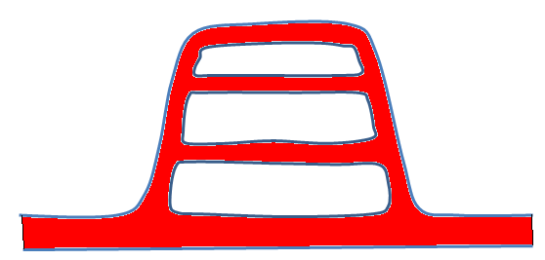
1. Vasodilation
Nerve impulses are sent from the hypothalamus to the smooth muscle in skin arterioles.
This causes the smooth muscle to relax, opening up blood capillaries near the surface of the skin.
Blood flows near the skin surface now, and heat can be radiated away.
Source: vbio.weebly.com, Thermoregulation

Slide 19
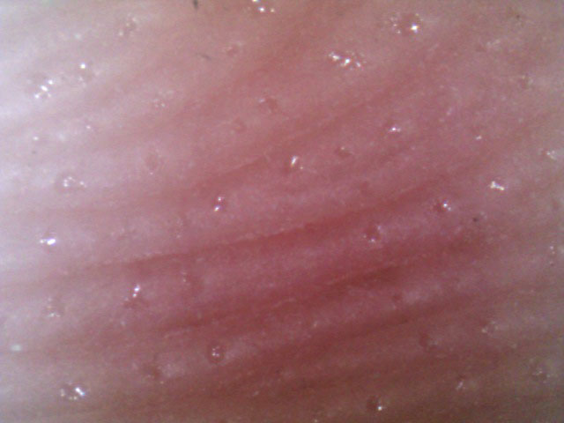
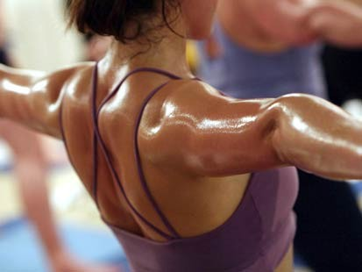
2. Increased sweating
Vasodilation also increases blood flow to the sweat glands.
This causes more sweat to be secreted onto the surface of the skin.
The sweat evaporates from the skin, causing a cooling effect.
Source: vbio.weebly.com, Thermoregulation

Slide 20
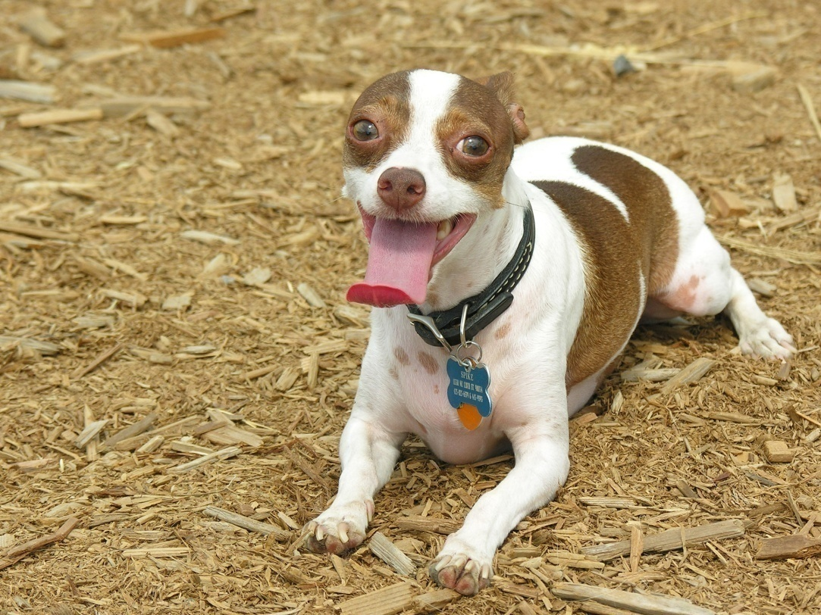
3. Panting
Some animals have few, if any sweat glands at all. They lose heat by panting.
Panting involves quick, short breaths of air, which evaporate water from the tongue, producing a cooling effect.
Source: vbio.weebly.com, Thermoregulation

Slide 21
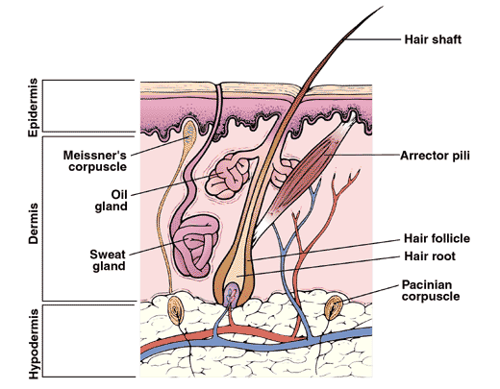
4. Pilorelaxation
Nerve impulses to cause erector pili muscles to relax, causing hairs on the body surface to lie flat.
This means that less air is trapped between the hairs and the skin, causing less insulation.
Source: vbio.weebly.com, Thermoregulation

Slide 22
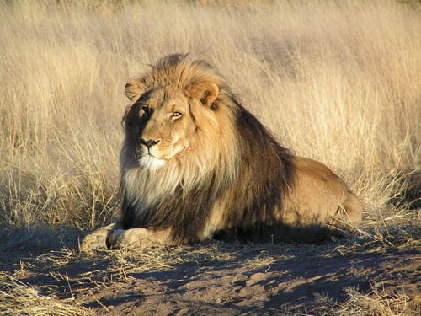
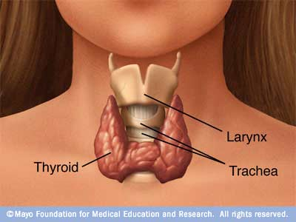
5. Behavioural/Metabolic changes
Inactivity – this is also a behavioural change that results in less energy being used for respiration. Less heat is produced.
Decreased metabolism – In extreme cases, long-term exposure to high temperature, the thyroid gland suppresses thyroxine, which reduces the metabolism.
Source: vbio.weebly.com, Thermoregulation

Slide 23
What to do for prevention short vs long term?
Cooling vs Acclimatization

Slide 24
Acclimatization
Increased plasma volume
Increased sweat response
Reduced rate of muscle glycogen utilization

Slide 25
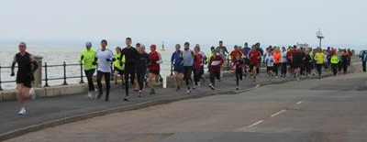
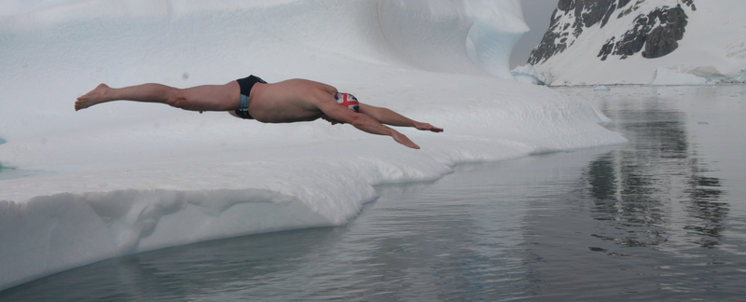
Exercise in cold, risks and precautions
Hypothermia happens when the core body temperature falls below about 35.5^{O}C for a sustained period of time.
Symptoms include sever shivering, muscle mis-coordination, metabolic shutdown and reduced brain-activity.
Windchill increases the rate of the heat loss via convection and conduction caused by wind.
Risks: frostbite and hypothermia
Source: vbio.weebly.com, Thermoregulation

Slide 26
If the body/skin temperature gets too low....
... the thermoreceptors detect this, and send impulses to the hypothalamus. The hypothalamus brings about corrective mechanisms to increase the core body temp:
PERIPHERAL VASOCONSTRICTION: allows LESS blood to the surface of the skin.
DECREASED SWEATING
PILOERECTION: hairs lie flat. More air trapped = more insulation.
SHIVERING: increases metabolism by respiration.
INCREASED METABOLISM: metabolic rate increased.
Source: vbio.weebly.com, Thermoregulation

Slide 27
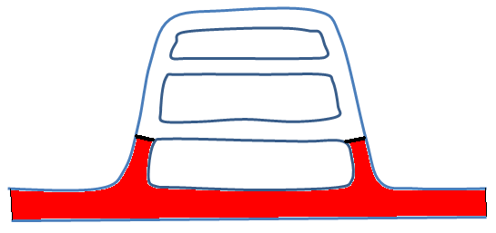
1. Vasoconstriction
Nerve impulses from the hypothalamus to the smooth muscle in the arterioles cause them to contract.
Blood is diverted away from the capillaries near the skin, so less heat is lost by radiation.
This why you look paler on a cold day.
Source: vbio.weebly.com, Thermoregulation

Slide 28
2. Decreased sweating
Vasoconstriction also decreases blood flow to the sweat glands.
This causes less sweat to be secreted onto the surface of the skin.
Less heat energy will be lost as there will be no ‘cooling effect.’
Source: vbio.weebly.com, Thermoregulation

Slide 29
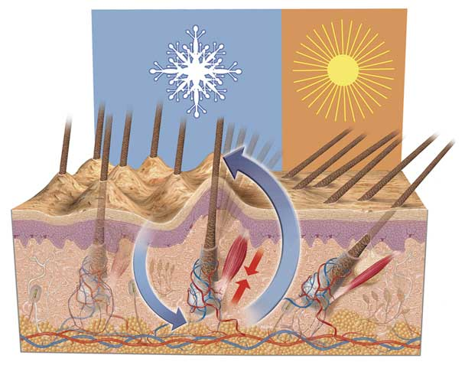
3. Piloerection
Nerve impulses to cause erector pili muscles to contract, causing hairs on the body surface to be pulled up straight.
This means that more air is trapped between the hairs and the skin, causing more insulation. This not very useful in humans, but is good for furry mammals.
Source: vbio.weebly.com, Thermoregulation

Slide 30
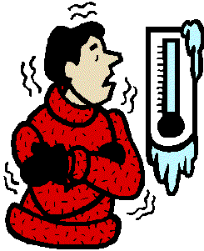
4. Shivering
Skeletal muscles contract and relax rapidly. Non-shivering thermogenisis: stimulation of the metabolism by the sympathetic nervous system to generate more metabolic heat
As the muscles are increasing their activity, the rate of respiration increases.
This increase cause the release of heat energy (4-5 fold), which increases the core body temperature.
Source: vbio.weebly.com, Thermoregulation

Slide 31
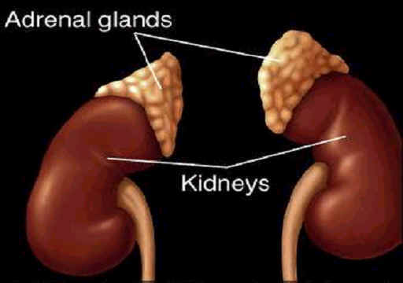
5. Metabolic changes
The hormone adrenaline is released by the adrenal gland. This causes a great increase in metabolic rate, resulting in heat production.
Long-term exposure to low temperatures causes the release of thyroxine by the thyroid gland – this causes sustained increases in metabolism.
Source: vbio.weebly.com, Thermoregulation

Slide 32
What to do for prevention short vs long term?
Best way to minimize heat loss is through insulation

Slide 33
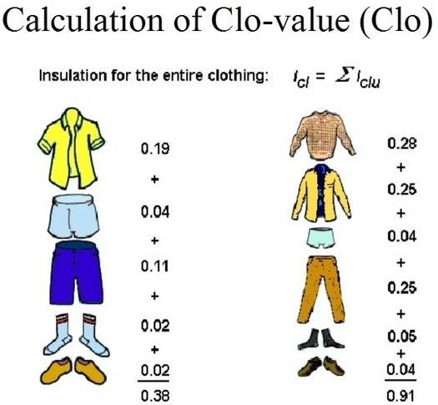
Precautions
Fat/clothing = insulation…
Insulation is measured in clo

Slide 34
Summary
High Temperatures
Low Temperatures
Vasodilation
Sweating
Panting
Pilorelaxation
Decreased metabolism
Vasoconstriction
Decreased sweating
Piloerectrion
Shivering
Increased metabolism
Source: vbio.weebly.com, Thermoregulation

