Slide 1
Joint and Movement Type
- Types of Muscle Contraction
Delayed onset muscle soreness (DOMS)

Slide 2
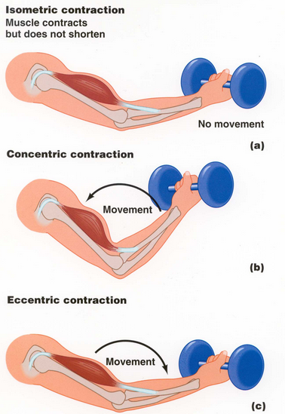
Types of Muscle Contraction
Isotonic contraction: tension (load) remains steady while skeletal muscle length lengthens and shortens
Holliman, Casey, 2013

Slide 3
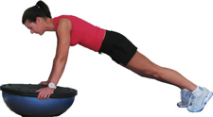
Types of Muscle Contraction
Isometric contraction:
Diets in Review, 2013

Slide 4
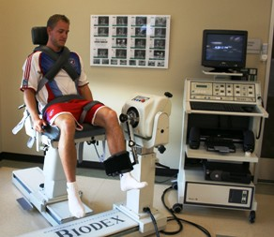
Types of Muscle Contraction
Isokinetic contraction: the speed of movement is fixed and the resistance varies with the force exerted.
Lifetime Fitness Nutrition, 2013

Slide 5
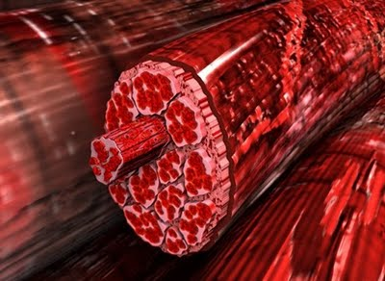
Delayed onset muscle soreness (DOMS)
The pain and stiffness felt in muscles several hours to days after unaccustomed and/or strenuous exercise.
This is brought on by eccentric contractions of the muscle causing tears and pressure at the nerve endings.
This can be minimized by gradual training, warm-up, etc.
Butters, Laura, 2013
Video: (D.O.M.S.)

Slide 6
Sources:
Holliman, Casey. "Myth about Lactic Acid Build-up and Delayed Onset Muscle Soreness (DOMS)." Performance Bodywork, Therapeutic and Sports Massage. Wordpress, 01 Jan. 2013. Web. 06 Nov. 2013
Diets in Review. "Top 5 Isometric Core Exercises." Diets in Review Blog RSS. Diets in Review, 30 July 2008. Web. 06 Nov. 2013.
Lifetime Fitness Nutrition. "Isokinetics, Another Weight Training Method." Weight Training, Observations, Guidelines, Equipment, Exercises, Workouts, Etc. Lifetime Fitness Nutrition, 01 Jan. 2013. Web. 06 Nov. 2013.
Butters, Laura. "D.O.M.S." Transformation Trainer RSS. Wordpress, 12 June 2012. Web. 06 Nov. 2013.

