Slide 1
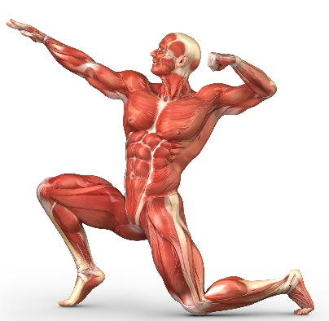
Section 1: Anatomy
Muscular System
Outline
General characteristics of common muscle tissue
Muscle types (smooth, cardiac and skeletal)
Structure of skeletal muscles
Major skeletal muscles and types of movement
Samuel, 2011

Slide 2
Robinson, 2011

Slide 3
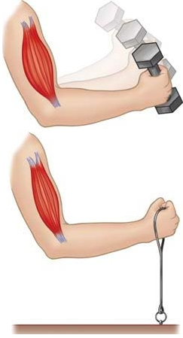
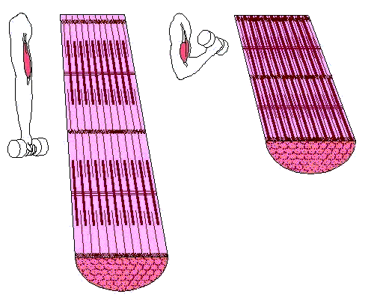
General Characteristics of common muscle tissue
Contractility: ability of the muscle to shorten
Adapted from FreeDictionary.com, 2013 and The Science of Bodybuilding, 2012

Slide 4
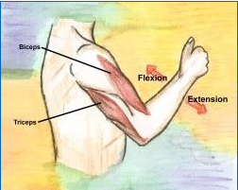
General Characteristics of common muscle tissue
Extensibility: ability of the muscle to lengthen
Discuss: Prime mover, synergist, agonists vs antagonist and reciprocal inhibition
Neurological Examination, 2009
Notes:
Agonist: muscle that causes the movement.
Antagonist: muscle that works opposite the agonist to return the joint to its initial position.
Reciprocal Inhibition: describes muscles on one side of a joint relaxing while the other side is contracting. (antagonistic pairs) When the central nervous system sends a message to the agonist (muscle causing movement) to contract, the tension in the antagonist (muscle opposing movement) is inhibited by impulses from motor neurons, and thus must simultaneously relax. This neural phenomenon is called reciprocal inhibition.

Slide 5
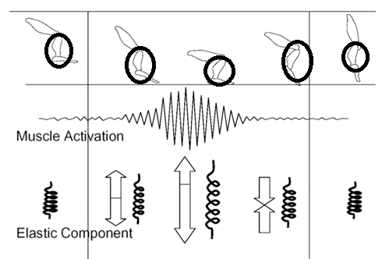
General Characteristics of common muscle tissue
Elasticity: ability of the muscle to return to normal size
Adapted from Lyman, 2009

Slide 6
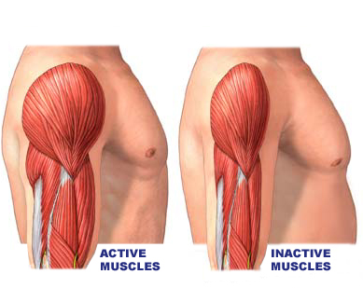
General Characteristics of common muscle tissue
Atrophy: the wasting of the muscle tissue
Atrophy Images and Graphics, 2012

Slide 7
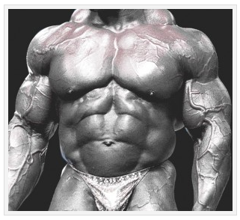
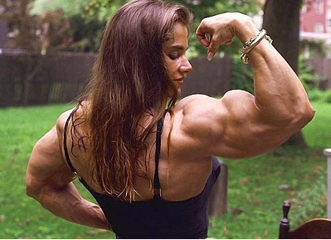
General Characteristics of common muscle tissue
Hypertrophy: is the increase in size of muscle tissue
All Communities, 2010 and For Bodybuilders-Anabolic Steroids, 2010

Slide 8
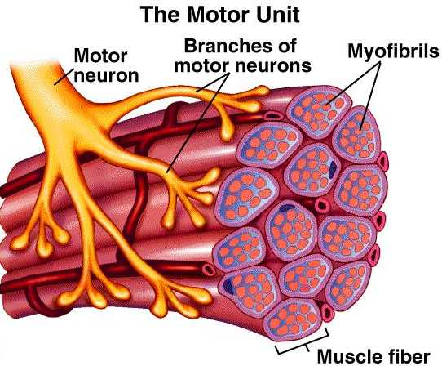
General Characteristics of common muscle tissue
All muscles are controlled by nerve stimuli and fed by capillaries
A Scientific Approach, 2011

Slide 9
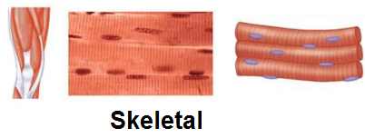
Muscle types
Adapted from MUSCLE PHYSIOLOGY, 2013
- attached to bones
- striated (the fibers contain alternating light and dark bands aka striations)
- contract and relax by conscious control (voluntary)

Slide 10
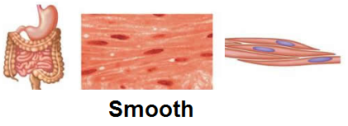
Muscle types
Adapted from MUSCLE PHYSIOLOGY, 2013
- walls of hollow internal structures such as blood vessels, the stomach, intestines, and urinary bladder
- nonstriated (smooth)
- do not contract under conscious control (involuntary)

Slide 11
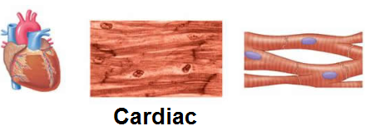
Muscle types
Adapted from MUSCLE PHYSIOLOGY, 2013
- forms the bulk of the wall of the heart
striated (the muscle fibers contain striations
contraction is involuntary

Slide 12
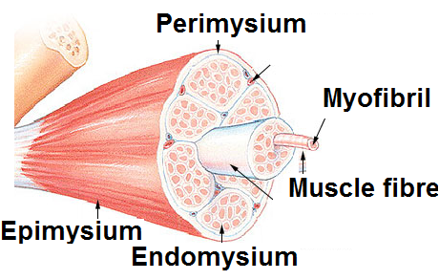
Structure of skeletal muscles
Adapted from Ritchison, 2012
A Scientific Approach, 2011
Notes:
Epimysium: connective tissue capsule.
Perimysium: within the muscle tissue there is branching connective tissue called perimysium.
Endomysium: the muscle cells themselves are individually wrapped in endomysium.
Myofibril: the muscle cells are filled with cylindrical structures called myofibrils.
These contain the myofilaments whose action is responsible for the contraction of the myofibrils and therefore the muscle as a whole.

Slide 13
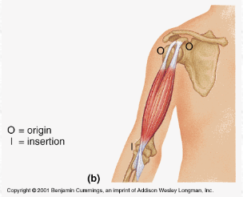
Structure of skeletal muscles
Origin: the point where the tendon attaches to the bone which does not move during muscle action.
Insertion: the point where the tendon attaches to the bone which moves during an action.

Slide 14
Major skeletal muscles
(n)App time – Visible Body
Sartorius
Deltoid
Pectoralis (major)
Quadriceps femoris
(rectus femoris, vastus intermedialis, vastus medialis, vastus lateralis)
Latissimus dorsi
Trapezius
Triceps brachii
Erector spinae
Biceps brachii
Hamstrings
(biceps femoris, semitendinosus, semimembranosus)
Gluteus maximus
External obliques
Abdominus rectus
Tibialis anterior
Iliopsoas
Gastrocnemius
Soleus

Slide 15
Resources:
"A Scientific Approach." Overview. Exerbotics, 2011. Web. 06 Apr. 2013.
"All Communities." Most Popular Personal Stories and Experiences. Experienceproject, n.d. Web. 06 May 2012.
"Atrophy Images and Graphics." Atrophy Images, Graphics, Comments and Pictures. Funscrape, n.d. Web. 06 Sep. 2012.
“Isotonic (A) and Isometric (B) Contraction.” FreeDictionary.com, 2013. Web. 06 Apr. 2013.
"For Bodybuilders-Anabolic Steroids." For BodybuildersAnabolic Steroids RSS. Forbodybuilders, July 2010. Web. 06 Apr. 2013.
Lyman, Al. "Improve Your Functional Strength and Muscle Elasticity for Better Running This Season and Beyond | Trifuel." Improve Your Functional Strength and Muscle Elasticity for Better Running This Season and Beyond | Trifuel. Trifuel, 21 Jan. 2009. Web. 06 Apr. 2013.
"MUSCLE PHYSIOLOGY." Physproject-2011 - M. MUSCLE PHYSIOLOGY. Tangient LLC, 2013. Web. 06 Apr. 2013.

Slide 16
"Neurological Examination, Myotomes." Neurological Examination. Northern California Neurosurgery Medical Group, 11 Oct. 2009. Web. 06 Apr. 2013.
Ritchison, Gary. "Human Physiology - Muscle." Human Physiology - Muscle. Gary Ritchison, 2012. Web. 06 Apr. 2012.
Robinson, Amy. "Infographic Series on the Human Body." Web log post. Amy Robinson. WordPress.com., 10 Oct. 2011. Web. 06 Apr. 2013.
Samuel, Leslie. "An Introduction to Skeletal Muscle Contraction." Interactive Biology by Leslie Samuel. Interactive Biology, 08 Mar. 2011. Web. 06 Apr. 2013.
"The Science of Bodybuilding." The Science of Bodybuilding. Body Building Newsarticles, n.d. Web. 6 Sept. 2012.

