Slide 1
Neuromuscular Function
Neuron
Motor Unit
Neurotransmitters
Muscle contraction

Slide 2
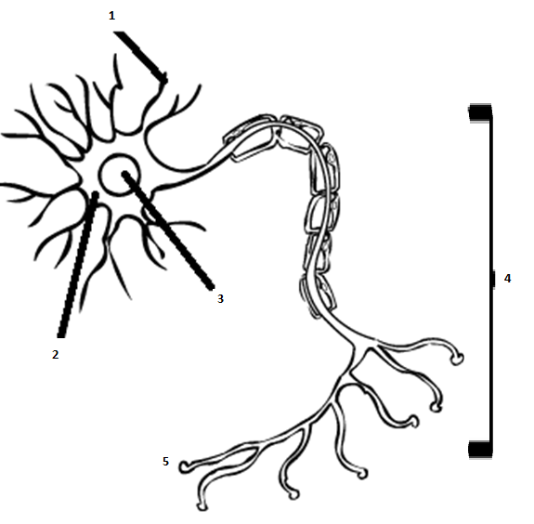
Notes:
Dendrites are thin structures that arise from the cell body, often extending for hundreds of micrometres and branching multiple times, giving rise to a complex "dendritic tree". An axon is a special cellular extension that arises from the cell body at a site called the axon hillock and travels for a distance, as far as 1 m in humans or even more in other species. The cell body of a neuron frequently gives rise to multiple dendrites, but never to more than one axon, although the axon may branch hundreds of times before it terminates. At the majority of synapses, signals are sent from the axon of one neuron to a dendrite of another. There are, however, many exceptions to these rules: neurons that lack dendrites, neurons that have no axon, synapses that connect an axon to another axon or a dendrite to another dendrite, etc.

Slide 3
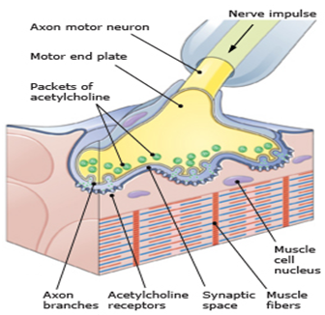
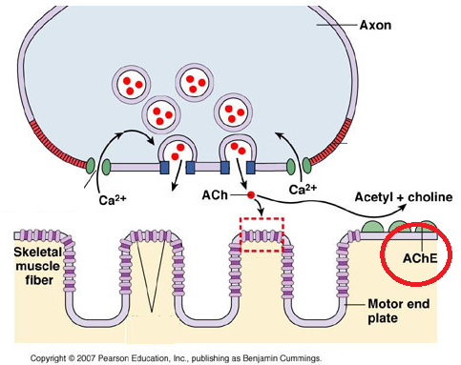
Neurotransmitter
Acetylcholine
Acetylcholine (ACh) → START
Enzyme: Acetylcholinesterase (AChE)
→
STOP
Notes:
Neurotransmitters are chemicals that are used for communication between a neuron at the synapse and another cell.
Acetylcholine is carried in little vesicles at the end of the neuron. The nerve impulse comes down the neuron and releases the acetylcholine, a neurotransmitter, into the space or the cleft. The acetylcholine crosses the cleft and enters the motor end plate through a specific receptor designed to accept the acetylcholine. Once the acetylcholine enters the motor end plate acetylcholinesterase is released. Acetylcholinesterase breaks down the acetylcholine and the process stops.

Slide 4
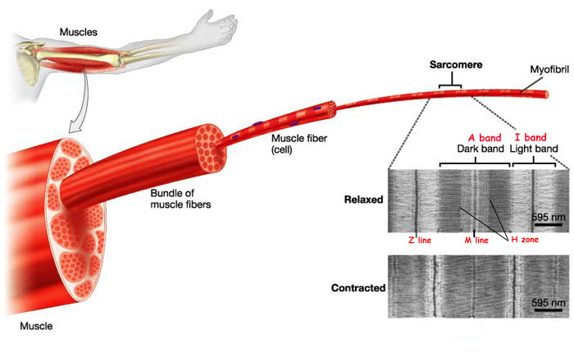
Skeletal Muscle contraction Sliding filament theory Clip: Sliding Filament Theory
Notes:
When muscle contracts, muscle fibres shorten. How do they shorten? The explanation for this phenomenon is termed the Sliding Filament Theory.

Slide 5
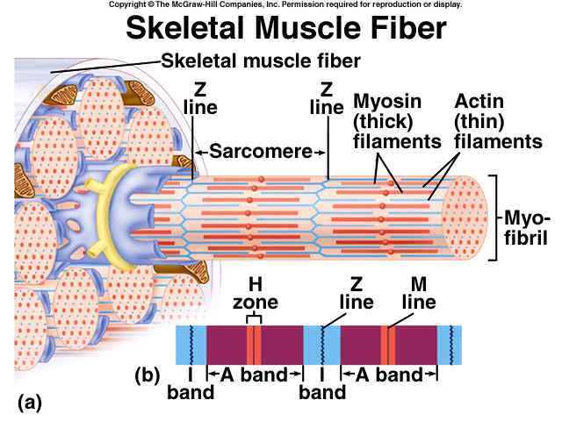
Skeletal Muscle contraction Sliding filament theory
Notes:
Myofibril
Sarcomere
Myofilament
Actin and myosin
H zone
A band
Z line
(Tropomyosin is an actin-binding protein that regulates actin mechanics.)
Troponin is a complex of three proteins that is integral to muscle contraction in skeletal and cardiac muscle, but not smooth muscle. Troponin is attached to the protein tropomyosin and lies within the groove between actin filaments in muscle tissue. In a relaxed muscle, tropomyosin blocks the attachment site for the myosin crossbridge, thus preventing contraction.
The sarcoplasmic reticulum is a special type of smooth ER found in smooth and striated muscle. The only structural difference between this organelle and the smooth endoplasmic reticulum is the medley of protein they have, both bound to their membranes and drifting within the confines of their lumens. This fundamental difference is indicative of their functions: the smooth ER synthesizes molecules and the sarcoplasmic reticulum stores and pumps calcium ions. The sarcoplasmic reticulum contains large stores of calcium, which it sequesters and then releases when the cell is depolarized. This has the effect of triggering muscle contraction.
Calcimu ions
ATP

Slide 6
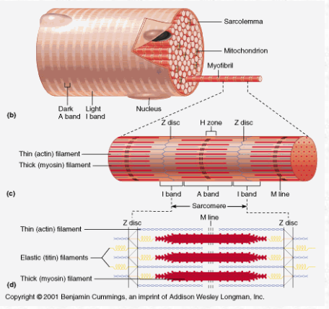
Notes:
There are 2 kinds of myofilaments:
(Thick and Thin)
Myosin: thick filaments
Actin: thin filaments
A unit of thick and thin filaments is known as a Sarcomere.
These structures hold the key to muscle contraction. Because of the staggered thin and thick filaments it has the effect as one might pull a rope towards oneself hand over hand.

Slide 8
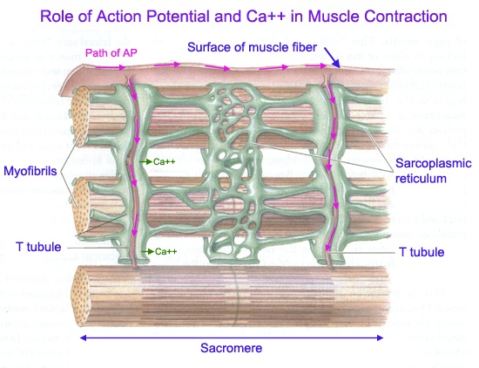
Sliding Filament Theory
Sodium ions cross the muscle membrane via sodium channels
Ca⁺⁺ are released by the sarcoplasmic reticulum and cross the muscle membrane via Calcium channels

Slide 9
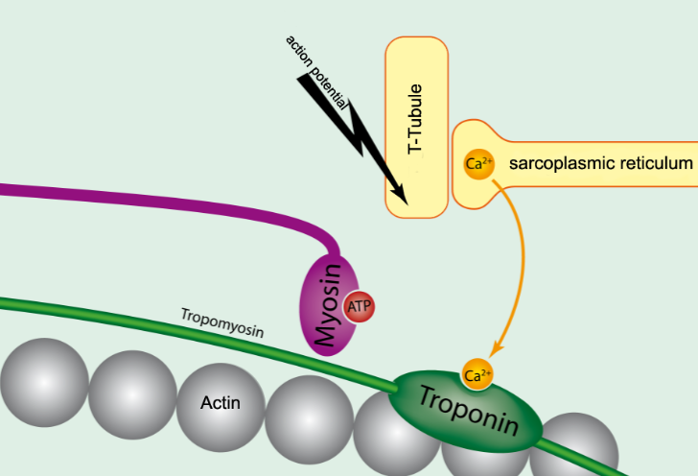
Ca⁺⁺ bind to troponin

Slide 10
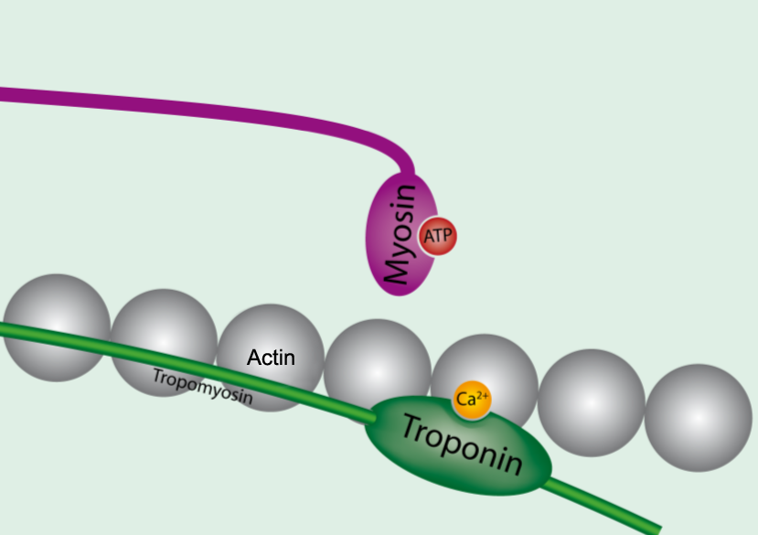
This prevents the blocking action of tropomyosin

Slide 11
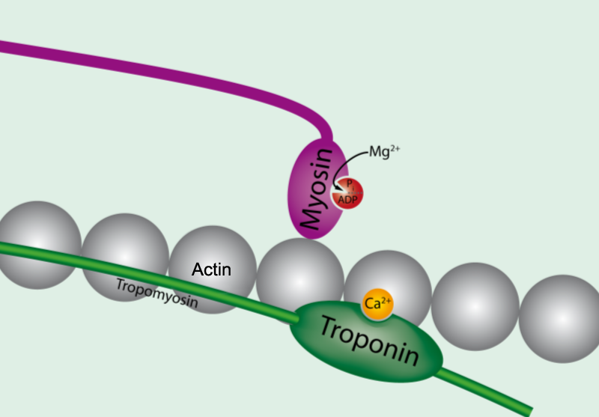
Myosin can now reach to bind to actin

Slide 12
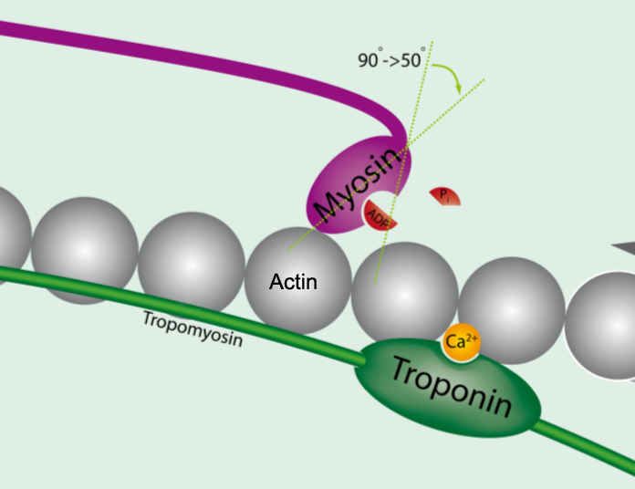
Myosin binds to actin and looses energy (ATP->ADP)
Notes:
Myosin tilts and drags the thin filament toward the centre of the sarcomere. This tilting of the head is referred to as the power stroke. The pulling of the thin filament past the thick filament shortens the sarcomere and generates force.

Slide 13
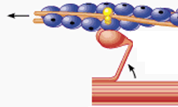
Power
stroke
Notes:
Myosin tilts and drags the thin filament toward the centre of the sarcomere. This tilting of the head is referred to as the power stroke. The pulling of the thin filament past the thick filament shortens the sarcomere and generates force. During this sliding (contraction), the thin filaments move toward the centre of the sarcomere and protrude into the H-zone, ultimately overlapping. When this occurs, the H zone is no longer visible.

Slide 14
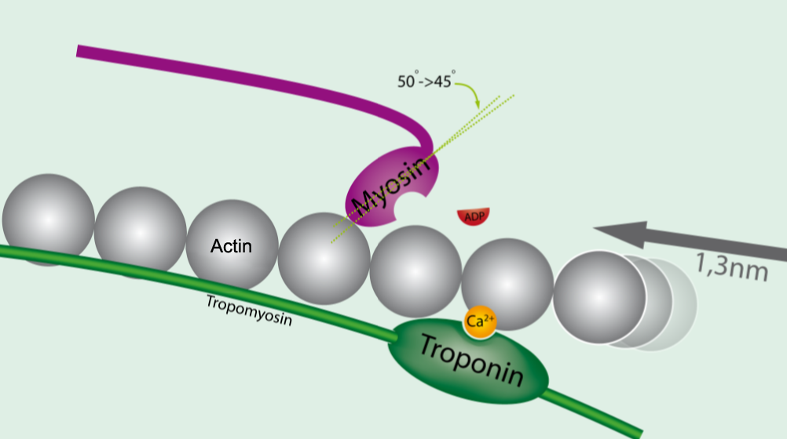
If there is no energy the cross-bridge remains, myosin is bound to actin and no further movement happens
Notes:
Immediately after the myosin head tilts, it breaks away from the active site, rotates back to its original position, and attaches to a new active site farther along the actin filament.
Repeated attachments and power strokes cause the filaments to slide past one another, giving rise to the term sliding filament theory. This process continues until the ends of the myosin filaments reaches the Z-disks, or until the Calcium is pumped back into the sarcoplasmic reticulum.

Slide 15
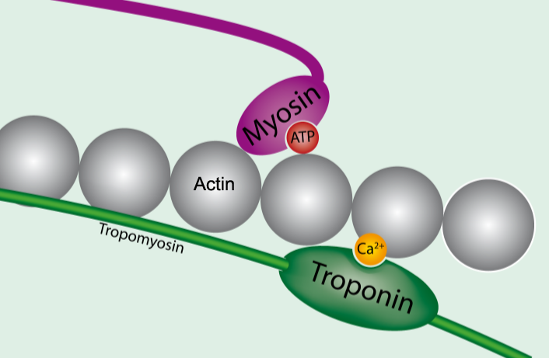
If there is energy (ATP) available new ATP is formed
Notes:
If there is energy available myosin returns to the original position repeating the previous steps creating the sliding filament action

Slide 16
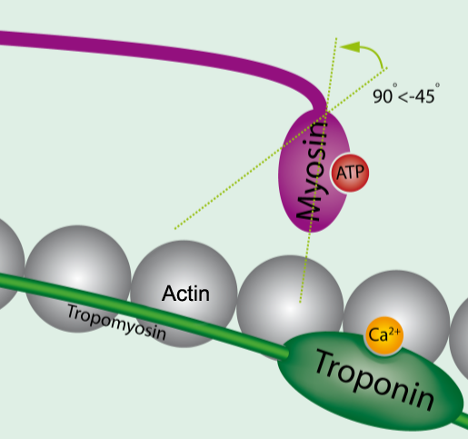
Myosin head releases the actin when a new ATP is formed

Slide 17
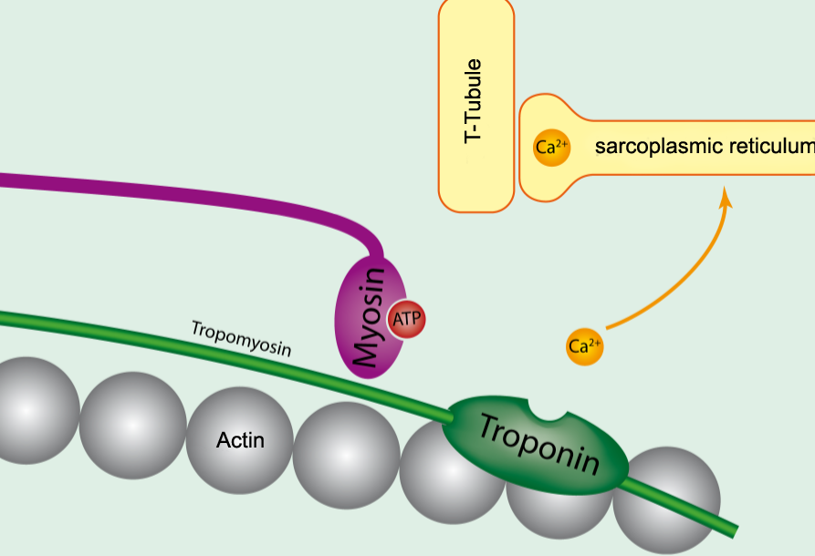
If Ca⁺⁺ ions is still present the sliding filament activity continues
If the AChE is released and Sarcoplacmic Reticulum takes up the Ca⁺⁺ ions myosin cannot bind any more and the muscle contraction stops

Slide 18
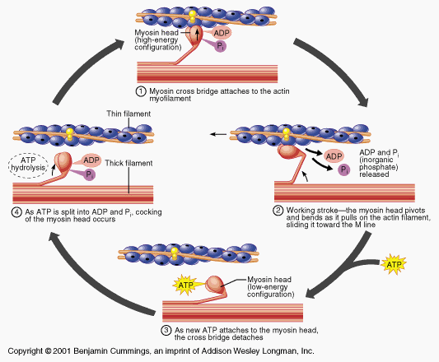

Slide 19
Resources
www.medcitynews.com/2012/01/biotech-startup-puts-new-spin-on-regenerative-medicine-for-nervous-system-repair/neuron-axon-dendrites/&ig=http://t2.gstatic.com/images?q=tbn:ANd9GcRp_Ye1oEmuP2ribt1YGv1yfBOcTpcil7Q_HfS7DFu-P4QyaQi82c2Gpqo&h=350&w=350&q=dendrites+neuron+axon&babsrc=HP_ss
http://upload.wikimedia.org/wikipedia/commons/1/10/Muskel-molekulartranslation.png
http://www.youtube.com/watch?v=hzXVe4RS8-A
http://www.youtube.com/watch?v=EdHzKYDxrKc
http://www.youtube.com/watch?v=e3Nq-P1ww5E&feature=related

