Slide 1
Option A
Optimizing physiological performance
Outline
Non-nutritional ergogenic aids
Environmental factors and performance
Training structure

Slide 2
Option A
Optimizing physiological performance:
Non-nutritional ergogenic aids
Outline
Ergogenic aids and performance
Placebo effect
Banned substances
Moral effects and long term implications

Slide 3
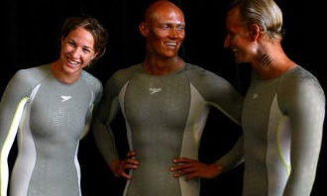
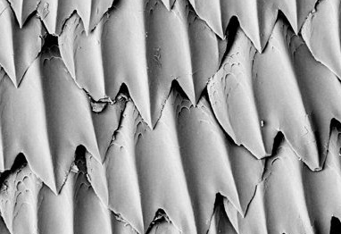
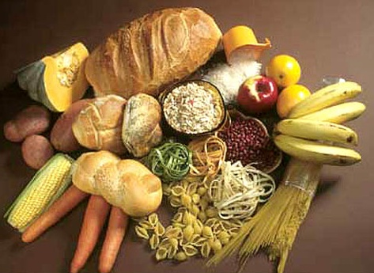
Ergogenic aids and performance
An ergogenic aid is any substance or phenomenon that improves an athletes performance.

Slide 4
Ergogenic aids and performance
Potential benefits
Improvement in both anaerobic and aerobic performance
- Increase in muscle mass and strength
Faster recovery between training sessions
Fasterrecovery from injury

Slide 5
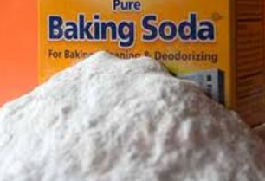
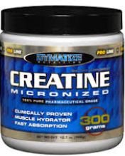
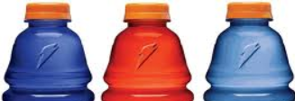
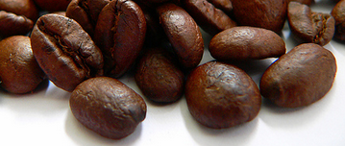
Nutritional Ergogenic aids
Nutritional ergogenic aids that can be found naturally in the body:
Creatine
Sodium bicarbonate
Sports drinks/bars and gels
Caffeine

Slide 6
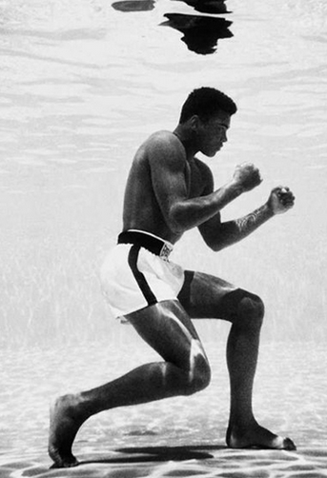
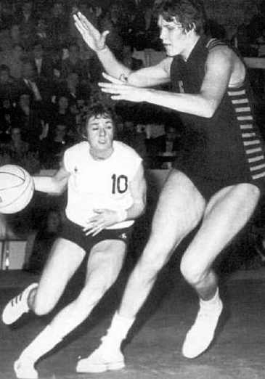
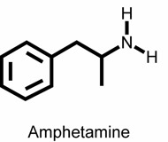
Non-nutritional Ergogenic aids
Mechanical
Pharmacological
Physiological
Psychological
Aids that cannot be found in the body

Slide 7
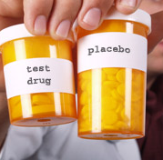
Placebo effect
A method of controlling the threats to the validity of your research
One can evaluate if the effect is produced by treatment or is merely a psychological effect

Slide 8
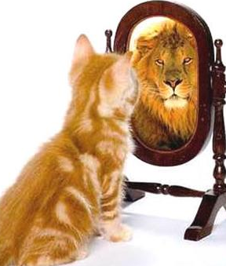
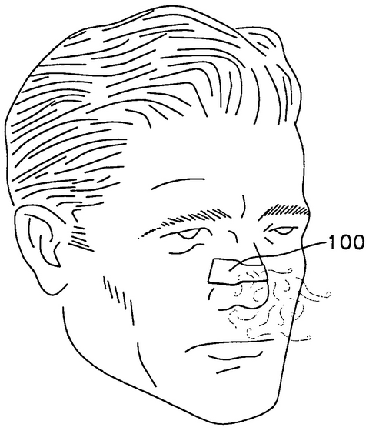
The self-fulfilling prophecy of the placebo effect
Sometimes there is no significant influence of using an aid and yet people choose to use it.

Slide 9
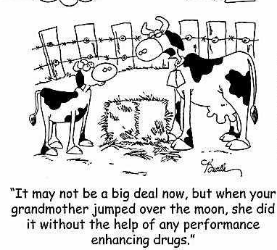

Slide 10
Banned substances by World Anti-doping Agency
Anabolic steroids
Hormones and related substances
Diuretics and masking agents
Beta blockers
Stimulants

Slide 11
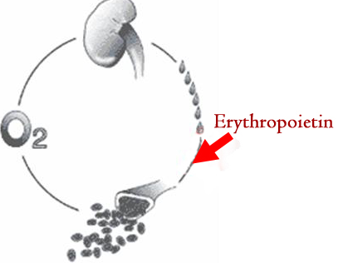
Erythropoietin (EPO)

Slide 12
Erythropoietin (EPO)
WHAT HAPPENS: Stimulates RBC production by stimulating red bone marrow cells.
Increases hemoglobin concentration.
LEADS TO: to improved aerobic capacity and thus improved performance in endurance races
CONSEQUENCES: Use of EPO may be detrimental to health due to the stresses on the cardiovascular system. This is due to the increased viscosity of the blood from the elevated RBC count. This may lead to increased risk of blood clotting resulting in heart attack, stroke and/or pulmonary embolism.

Slide 13
Moral effects and long term implications

