Slide 1
Anatomy
Skeletal System
Outline
Anatomical position
Directional terms
Axial and appendicular skeleton
Functions of the skeleton
- Support, protection, blood cell formation, mineral reservoir
- Attachment and movement

Slide 2
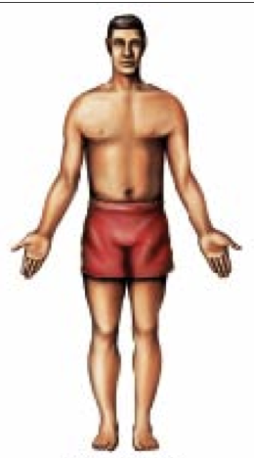
Anatomical position
Adapted from Roman, 2011

Slide 3
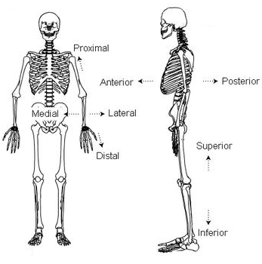
Directional terms
Adapted from Mennear, 2012

Slide 4
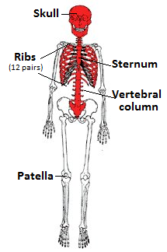
Axial skeleton (red)
ANTERIOR POSITION
Adapted from Rajczyk, 2008

Slide 5
Vertebral column
Cervical: Breakfast at 7
Thoracic: Lunch at 12
Lumbar: Dinner at 5
5 Sacral bones fused as 1
4 Coccyx bones fused as 1
Vertebral Column, 2013

Slide 6
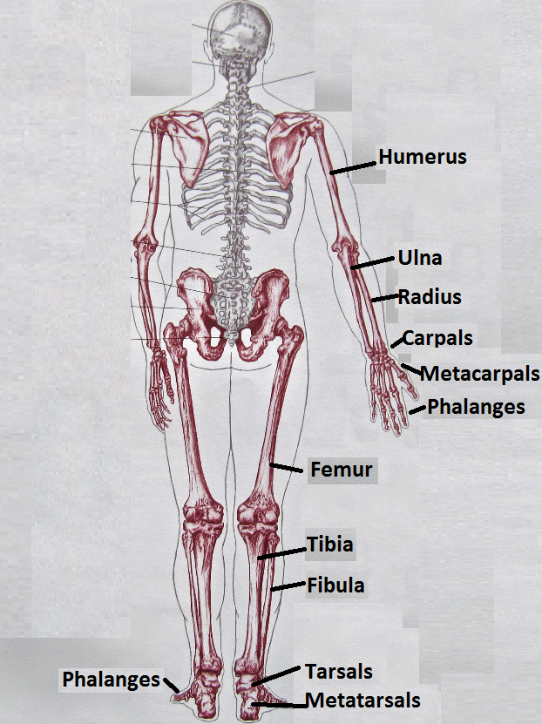
Appendicular skeleton (violet)
POSTERIOR POSITION
Adapted from Biel and Robin, 2005

Slide 7
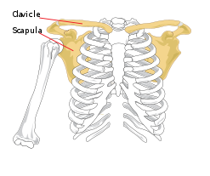
Appendicular skeleton PECTORAL GIRDLE
Adapted from Cibis, 2013

Slide 8
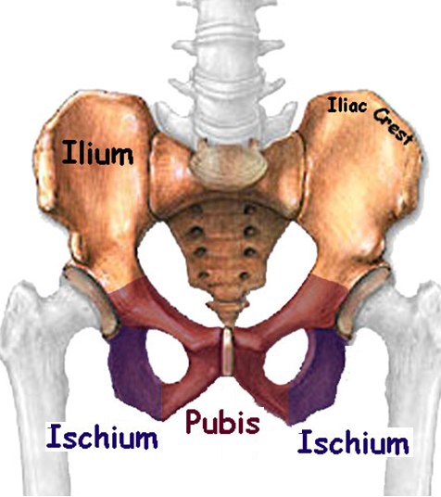
Appendicular skeleton PELVIC GIRDLE
Adapted from Shock, 1998

Slide 9
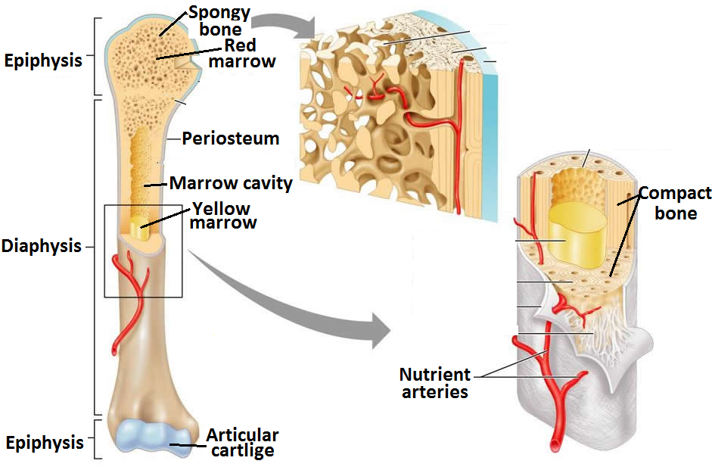
Functions of the skeleton Blood cell formation and mineral reservoir
Adapted from Veterinary Online, 2012

Slide 10
Functions of the skeleton Support and protection
Support = organs and tissues require structure
Protection = for various body organs

Slide 11
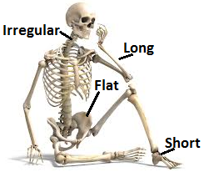
Functions of the skeleton Support and protection
Adapted from Williford, 2012

Slide 12
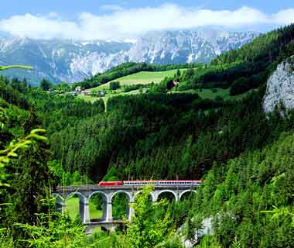
Functions of the skeleton Attachment and movement
Connective tissue provides support and/or attaches bones and/or muscles together as CARTLIGE, LIGAMENT OR TENDON
Travel Leisure, 2010

Slide 13
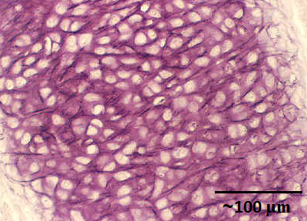
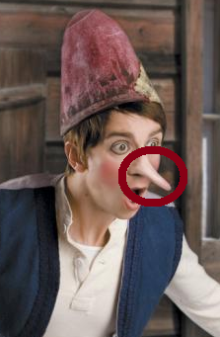
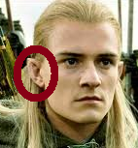
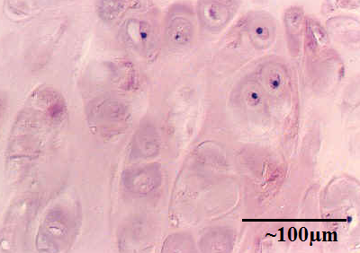
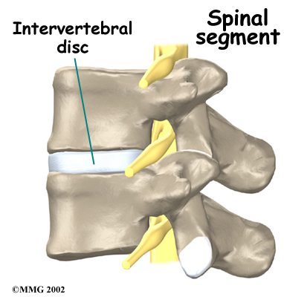
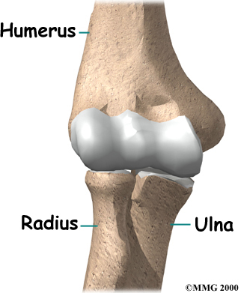
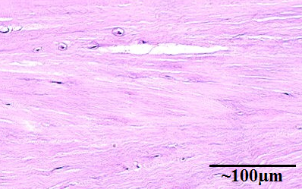
Functions of the skeleton Attachment and movement
Cartilage is a hard tissue.
There is elastic,
hyaline
and
fibrocartilage.
Adapted from Childs, 2011

Slide 14
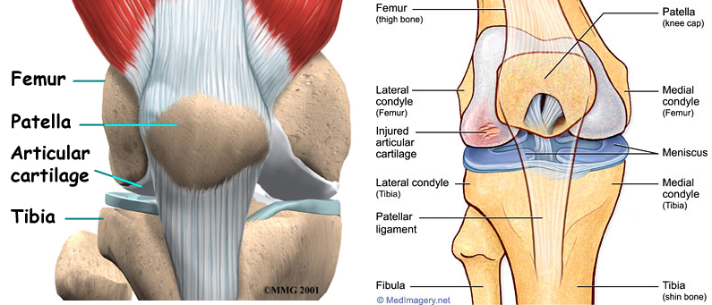
Functions of the skeleton Attachment and movement
1
4
1
4
5
5
6
2
3
Ligaments attach bone to bone (LBB)
Adapted from Barbara, 2013 and Medimagery.net, 2013

Slide 15
Functions of the skeleton Attachment and movement
Tendons attach muscle to bone (TMB)
?
Adapted from ATP, 2003

Slide 16
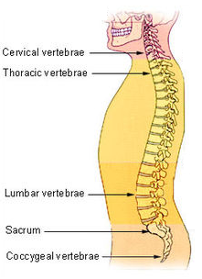
Functions of the skeleton Attachment and movement
Joint occurs where two or more bones articulate
Adapted from Barbara, 2013, Cibis, 2013, Medimagery.net, 2013, Vertebral Column, 2013

Slide 17
Functions of the skeleton Attachment and movement
Joint Structure | Joint Function | Joint Mobility | Examples
Fibrous | Syn- arthrotic | Immovable | Sutures of skull Tibiofibular syndesmosis of lower leg
Cartilaginous | Amphi- arthrotic | Slightly movable | Intervertebral joints Costochondral junctions of ribcage
Synovial | Di- arthrotic | Freely movable | Glenohumeral joint of shoulder Humeroulnar joint Tibiofemoral joint of knee
Fat CatS are S A D

Slide 18
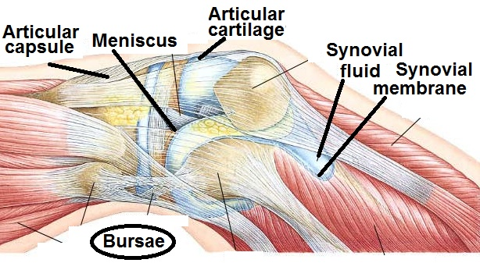
Functions of the skeleton Attachment and movement
Adapted from Navigation, 2013

Slide 19
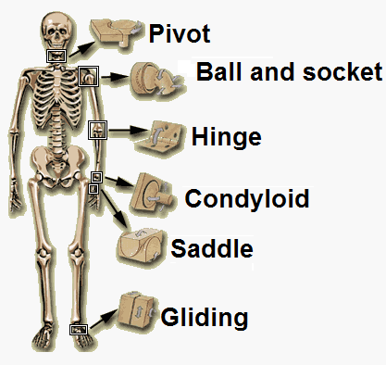
Functions of the skeleton Attachment and movement
Adapted from Arthmender, 2013

Slide 20
Resources:
"Joint Care." Arthmender for Joint Rejuvenation. Arthmender, n.d. Web. 06 Apr. 2013
"Achilles Tendon Problems." Http://www.methodistorthopedics.com/achilles-tendon-problems. The Methodist Hospital System, 2003. Web. 06 Apr. 2013.
Barbara, Deborah Day. "Growing New Cartilage." Growing New Cartilage. Johns Hopkins University, n.d. Web. 06 Apr. 2013.
Biel, Andrew, and Robin Dorn. Trail Guide to the Body: How to Locate Muscles, Bones, and More. 3rd ed. Boulder, CO: of Disocvery, 2005. Print. Page 41.
Cibis, V. "Rdfobi.de." Rdfobide. Haftungsausschluß, 01 Jan. 2013. Web. 06 Apr. 2013.
Childs, Gwen. "CARTILAGE." CARTILAGE. Gwen V. Childs, Ph.D., WebMistress, 21 Feb. 2011. Web. 06 Apr. 2013.
Mennear, David. "These Bones Of Mine." Web log post. These Bones Of Mine. Wordpress.com, 28 Feb. 2012. Web. 05 Apr. 2013.
MMG. "Elbow Replacement." Artificial Joint Replacement of the Elbow. MMC, 2000. Web. 06 Apr. 2013.
MMG. "Physiotherapy in Banff for Lower Back." Physiotherapy in Banff for Lower Back. MMG, 2002. Web. 06 Apr. 2013.

Slide 21
"Musculoskeletal Stock Art: Medical Imagery - Anatomical Art, Illustration, Graphics and Animation." MedImagery.net. Medical Imagery, n.d. Web. 06 Apr. 2013.
"Navigation." Joint Structure as It Should Be. CDC Wellbeing, n.d. Web. 06 Apr. 2013.
Rajczyk, Janet. "Human Biology." Weblog post. Human Biology. Blogspot.com, 12 Apr. 2008. Web. 05 Apr. 2013.
Roman, Enrique. General Concepts of Anatomy. Digital image. Exercise And Wellness 330 Pabedinskas Flashcards. STUDYBLUE INC, 6 Sept. 2011. Web. 05 Apr. 2013.
Shock, Cedric. Appendicular Skeleton: Pelvic Girdle. Digital image. Appendicular Skeleton: Pelvic Girdle. N.p., 1998. Web. 06 Apr. 2013.
"Travel Leisure." Travel Leisure. American Express Publishing Corporation, Mar. 2010. Web. 06 Apr. 2013.
Vertebral Column. Digital image. Wikipedia. Wikimedia Foundation, 04 June 2013. Web. 06 Apr. 2013.
"Veterinary Online- Bones." Veterinary Online- Bones. Blogspot.com, 2012. Web. 06 Apr. 2013.
Williford, Kristen. "Interactive Biology, by Leslie Samuel." Interactive Biology by Leslie Samuel. Nteractive Biology, by Leslie Samuel, July 2012. Web. 06 Apr. 2013.

