Slide 1
- Structure of ventilatory system - Functions of airways - Pulmonary ventilation mechanics - Alveoli exchange - Hemoglobin in oxygen transport - Nervous and chemical control during exercise - Total lung capacity - Vital capacity - Tidal volume - Expiratory reserve - Inspiratory reserve - Residual volume
Ventilatory System

Slide 2
TERMS:
Respiration (exchange) vs ventilation (flow)
External (lungs) vs Internal (body) respiration
Inspiration vs expiration
Oxygen, carbon dioxide, nitrogen etc.

Slide 3
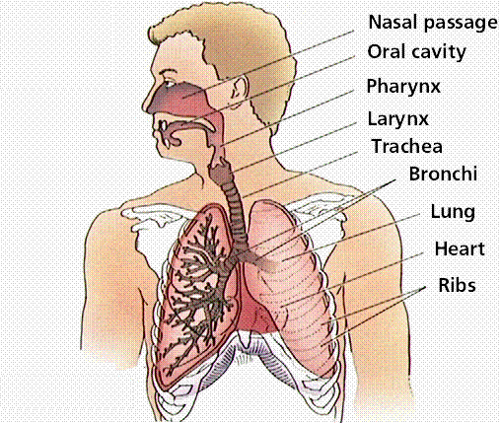
Structure of ventilatory system

Slide 4
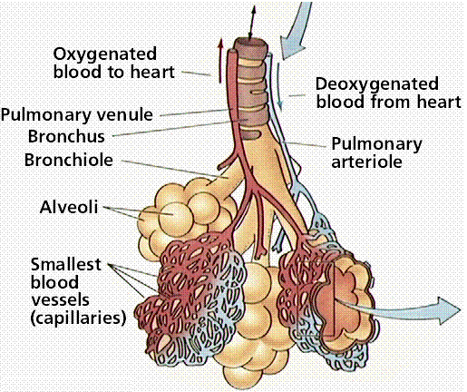
Structure of respiratory system in the thoracic cavity

Slide 5
Functions of airways
Passages via which air enters lungs provide for:
- low resistance
YET
protects against foreign particles (cilia, mucous)
warms air (capillaries)
hydrates air (mucous membranes)

Slide 6
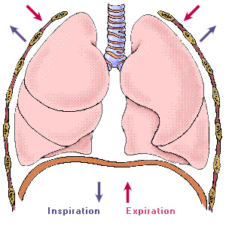
Pulmonary ventilation mechanics
Let’s listen to Tony
Boyle’s Law
Diaphragm
External and internal intercostal muscles
Sternocleidomastoid (SCM)
Scalenes

Slide 7
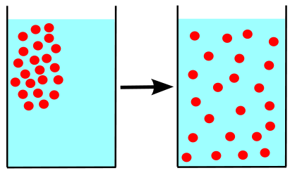
Alveoli exchange
Pulmonary Diffusion
High vs low pressure

Slide 8
Hemoglobin in oxygen transport

Slide 9
Gas exchange controls the rate of ventilation
Ventilatory rate is governed by carbon dioxide content in the blood. This is detected by the respiratory centre in the brain.
Peripheral chemoreceptors in aorta and carotid artery detect oxygen, carbon dioxide and pH levels.
Increased CO₂ and inability of lungs to expire. CO₂ then is stored in the blood as bicarbonate (HCO₃⁻).
To become bicarbonate, CO₂ first becomes carbonic acid (H₂CO₃). Then it breaks down into H⁺ and HCO₃⁻.
This decreases the pH in blood resulting in higher acidity.
Pulmonary stretch receptors and muscle proprioceptors receive information from muscles and joints.

Slide 10
Total lung capacity
Volume in the lungs after maximum inhalation

Slide 11
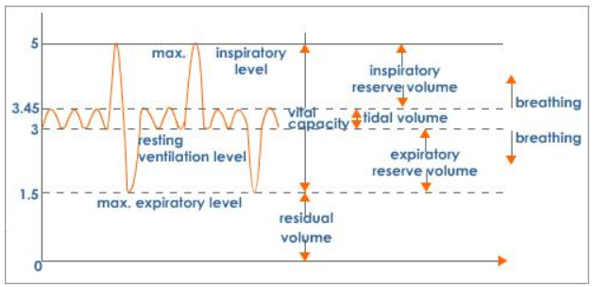
Lung volume - Spirogram
Page 34 of the book

Slide 12
Vital capacity
Maximum volume of air that can be exhaled after a maximum inhalation.
Total lung capacity can be calculated by adding vital capacity to residual volume of the lungs.

Slide 13
Residual volume
Amount after forcible exhale... That is volume of air still contained in the lungs after a maximal exhalation.

Slide 14
Tidal volume
Volume of air breathed in and out in any one breath. Usually this is around 500ml of air.

Slide 15
Expiratory reserve
The volume of air in excess of tidal volume that can be exhaled forcibly.

Slide 16
Inspiratory reserve
Additional inspired air over and above tidal volume. This may amount to more than 3 liters of air.

